Slide 1
Predictive maintenance using technologies provided by Industry 4.0

Slide 2


Introduction.
Predictive Analysis.
Implementation of technologies in Industry 4.0 (Zonta et al., 2020).
Understanding patterns for the betterment and improvement.
Understanding Predictive Analysis and Industry 4.0 Mean (Çınar et al., 2020).
Notes:
Predictive analysis is a system that makes real-time predictions of future situations and circumstances, with the help of historical data implemented with statistical models, data management systems, and deep machine learning. Companies who use this approach, help them track down certain patterns which help them understand the current market. When it boils down to Industry 4.0, it has implemented technological advances to its core and a few examples are, IoT, Cloud computational storage, Meta-Physicial systems, and lastly, smart manufacturing of products and services for better time management and effective delivery times.

Slide 3
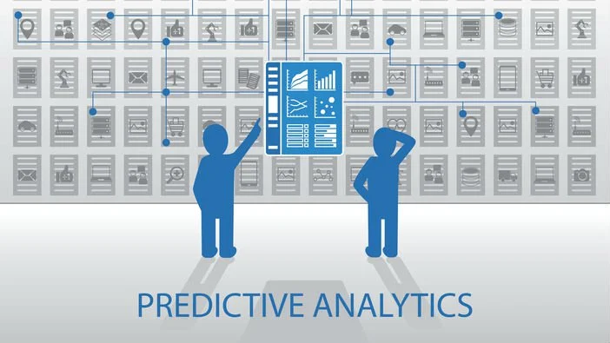
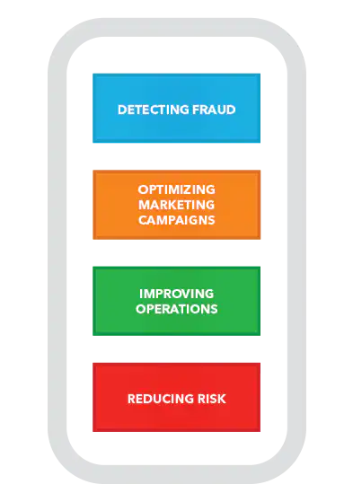
Predictive Analysis and its Specialities.
To gain an advantage over the competition (Kamble et al., 2021).
Finding better revenue opportunities.
Increases performance and processing capability (Raut et al., 2019).
Notes:
Predictive analysis can help any organisation gain quite a monumental reach and effective lead over the market and onto the competition they are facing, this results in better sales graphs and reach to the masses. With the help of historical data entries, the implementation of statistical analytics in the field helps an organisation conjure better and more efficient ideas for overall improvement. This improves the performance scale of the organisation resulting in better-timed delivery of services or goods and increasing processing capability whilst maintaining the quality of services and goods that are effectively handled by the organisation.

Slide 4
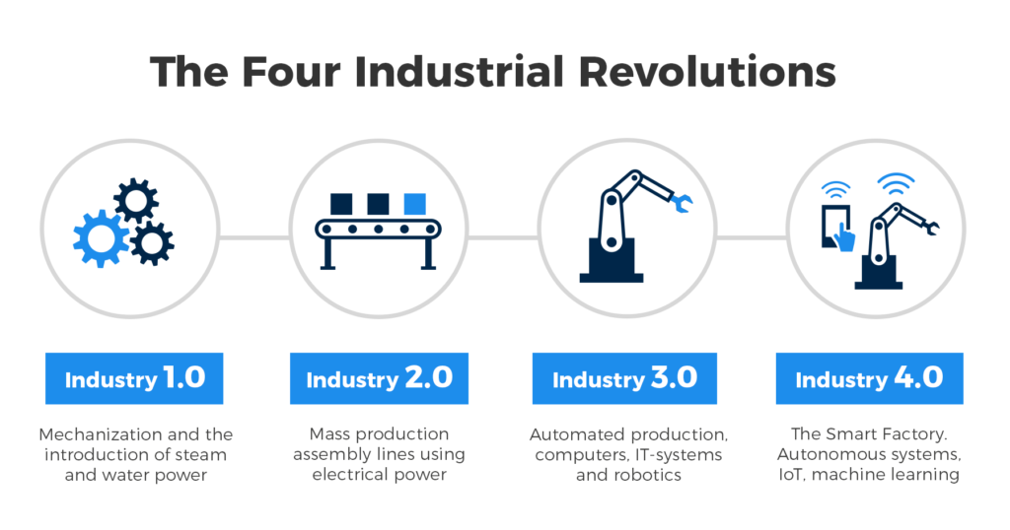
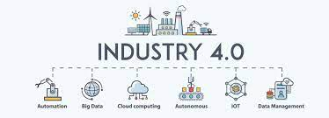
Industry 4.0 and its Specialities
Connectivity and Communication (Kamble et al.. 2020)
Intelligent Analytics.
Autonomous robotic influence at the industrial level (Chiarini and Kumar, 2021).
Notes:
With the introduction of technology in the field of the industrial revolution, communication is at the peak of its development and it is also developing on a daily purpose, communication has played a very critical role in the development of industry during the large-scale revolution, which is also called Industry 4.0. Intelligent analytics help in pattern recognition by the system for a better understanding of each customer’s behavioural advances in general. Autonomous robotic introduction into the industrial scale has saved an immense number of time, resources, and effective employees for other assignments, now all of the aforementioned tasks and functions would be completed by the robots.

Slide 5
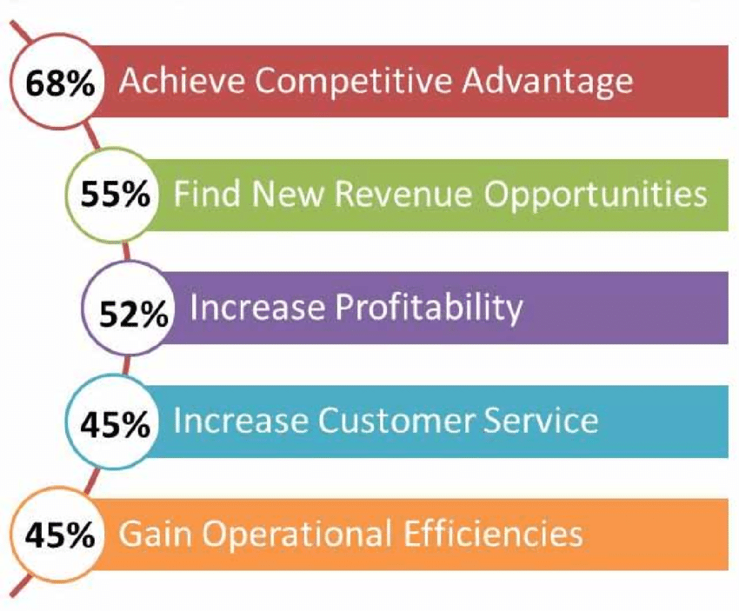
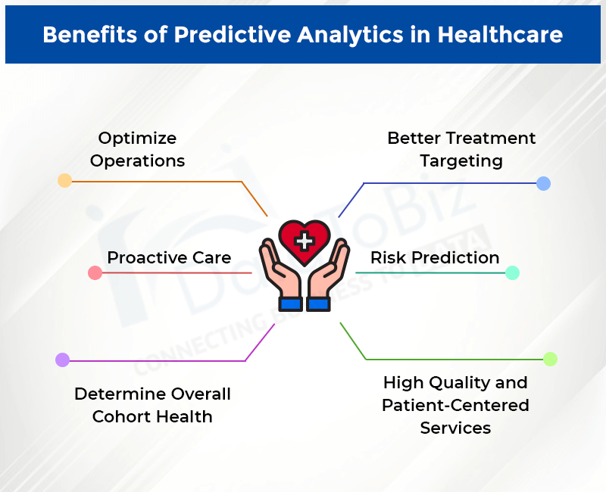
Advantages of Predictive Analysis.
Reduced and cost-effective measures.
Grasping what the customer wants (Henrys, 2021).
Optimising services and products (Gupta et al., 2020).
Notes:
Reducing cost through the implementation of technology available, that is, AI (Artificial Intelligence), helps in cutting down large amounts of cost on products and effective products without any error or hassle. Understanding and presenting the customers towards what they want and need is one of the biggest advantages of Predictive Analysis so far, it helps in retaining the customer and influencing the masses through them. Optimising the services that are already provided and used by the organisation would be extremely cost-cutting, effective, and highly time-saving resulting in netter delivery rates, reducing the cost of products, and services are easier to reach the masses.

Slide 6
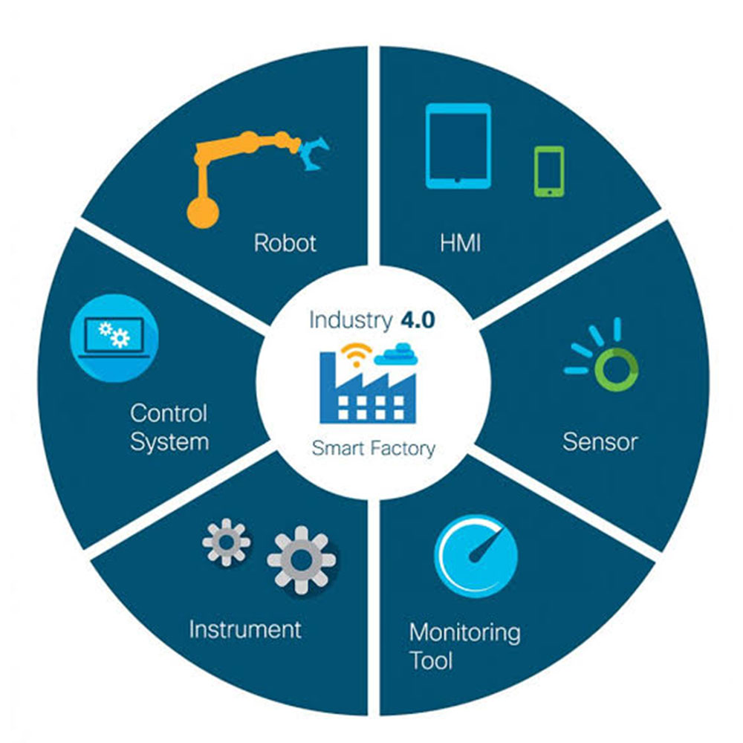
Advantages of Industry 4.0.
Better processing of products or services for customers (Sima et al., 2020).
Productivity and flexibility.
A tad bit more personalised and intelligent production (Frank et al., 2019).
Notes:
The implementation of technologies like AI (Artificial Intelligence) coupled with deep machine learning (quantum computing) helps in the behavioural understanding of the customers and would cater to their needs. Productivity and flexibility are at their absolute peak when it comes down to Industry 4.0, due to the technologically advanced usage of instruments and software for product manufacturing and by the way, this is only the beginning. Implementing AI-powered chatbots for customers to interact and record data helps the customers as well as the organisation to provide and produce the products they need.

Slide 7
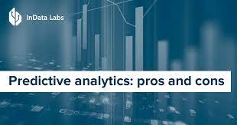
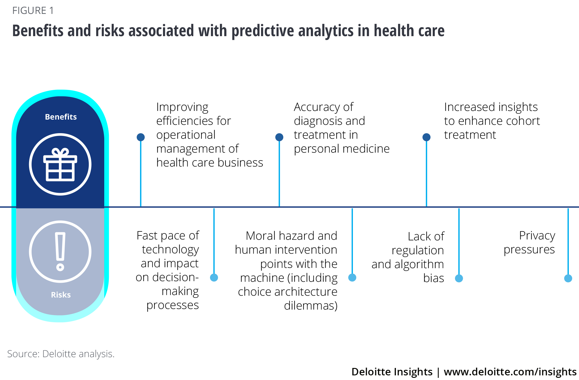
Limitations of Predictive Analysis.
Variables in the environment and many more changes.
The mood of the employees at the organisation or the customers.
Bad weather conditions hamper delivery and production.
Notes:
Variables in the environment and sudden changes mean, if any pandemic or epidemic is going on in the zone of interest by the organisation resulting in fewer sales gains and less profitability and losses that need to be accounted for. If the employees or the customers are unhappy with the organisation, that can make the organisation tank a full-on blow to its sales and production unit. Storms or heavy rains resulting in floods can cause stoppage of deliveries and can pose potential life-threatening conditions which can result in catastrophic consequences for the company.

Slide 8
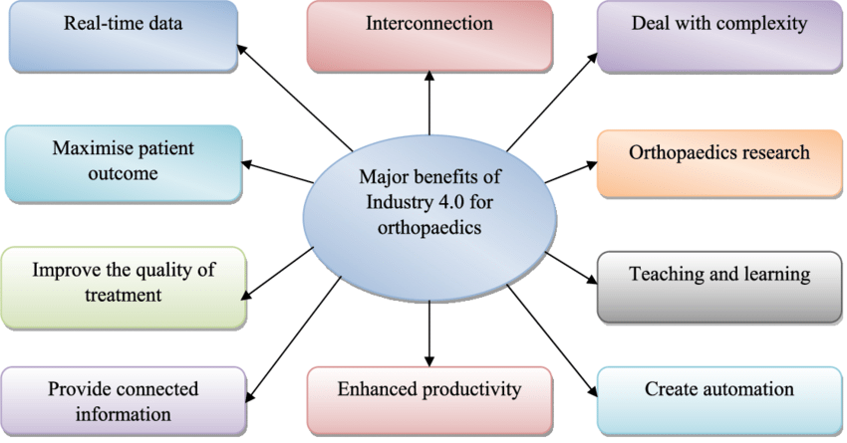
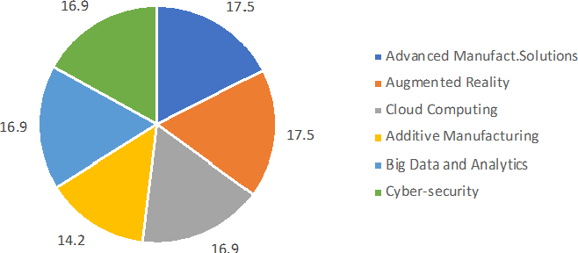
Limitations of Industry 4.0.
Unemployment.
Unknown to digital knowledge.
Higher rate of failure in the market.
Notes:
Unemployment here is caused by the very one thing that humans have created to aid themselves, that is, robots with in-built AI SoCs in the technological sector and the industrial sector. Robots with the help of AI are gaining knowledge incrementally on a daily purpose to complete tasks more efficiently. Most employees in the workplace or organisation are uneducated, resulting in few employees who can interpret computational knowledge. Implementing Industry 4.0 from the very start of an organisation from scratch is more failure prone than a normal organisation slowly implementing technological advances to themselves, due to an unknown brand name and no market reach.

Slide 9
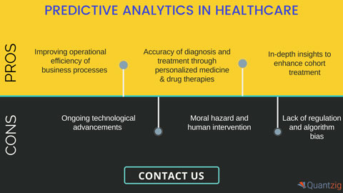
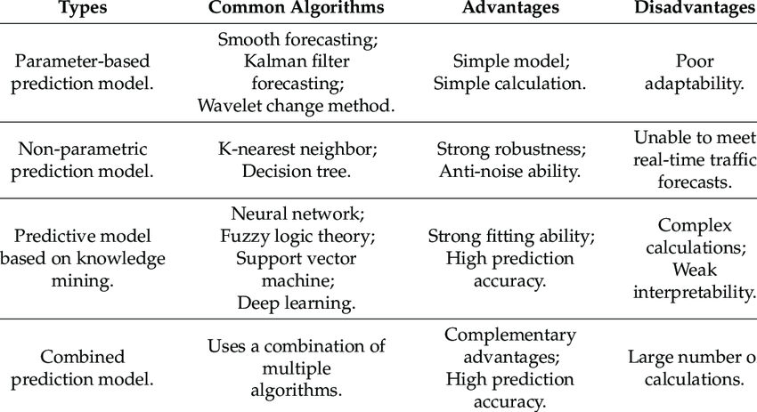
Disadvantages of Predictive Analysis.
Developing a crystal clear strategy.
Creating an employee-friendly working environment.
Making a realistic budget.
Notes:
Clearing out doubts and problems within the organisation during the presentation of the strategy should be the top priority and it should never be neglected to save precious time. If not, it can hamper the processing of products and the overall functionality of the organisation. Not having an employee-friendly work environment could result in a bad impression of the organisation by the employees resulting in not-so-great cooperation between the organisation and by rapid resignation. Not making having realistic goals and setting up a realistic budget could lead to cause immense losses that will cost a fortune.

Slide 10
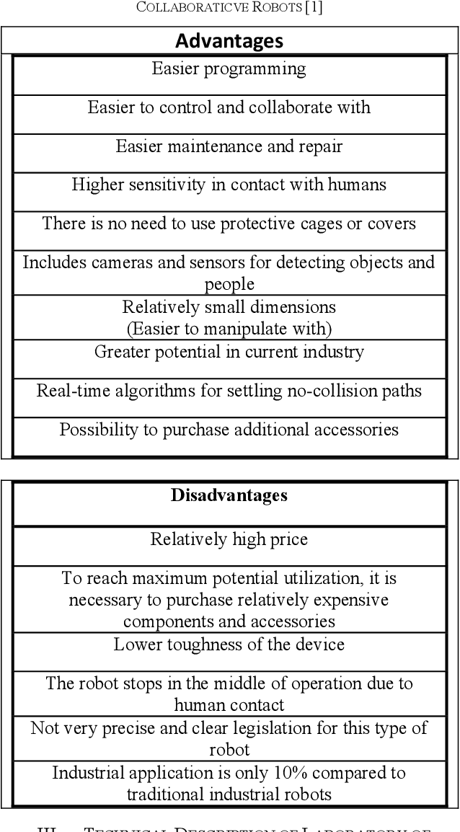
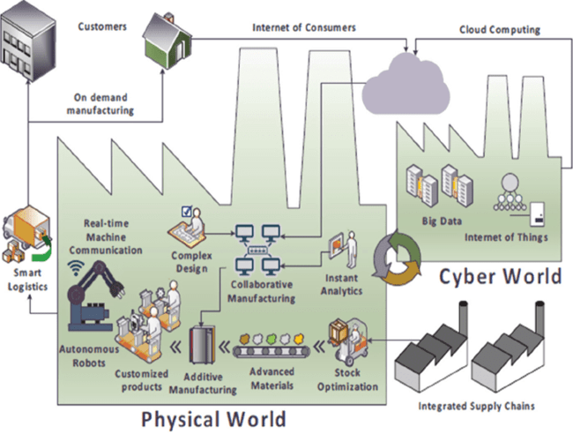
Disadvantages of Industry 4.0.
Inequality.
Lack of proper digital infrastructure.
Lack of business knowledge.
Notes:
Inequality is very high in 4IR (4th Industry Revolution), only due to the rich wanting to be richer from the efforts and the hard work of the poor instead of providing them subsidies for their hard work. Basic education cannot fulfil digital infrastructure-related work and thus, resulting in the irregular workflow. Most people would have basic knowledge, unfortunately, employees need to be educated about a few basics of business before they get employed.

Slide 11
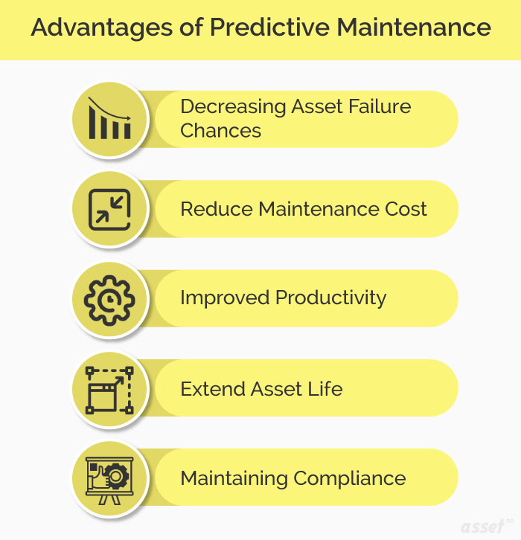
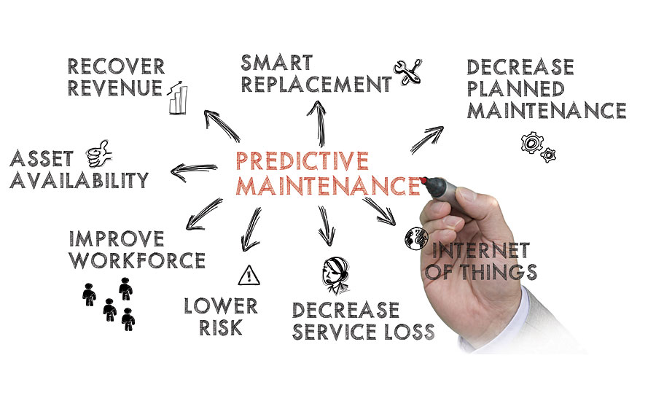
Advantages of Predictive Maintenance.
Preventing untimely system failure.
Reduced maintenance costs.
Equipment longevity is maintained (Pech et al., 2021).
Notes:
Preventing untimely system failure and regular checking helps in the long run and maintains the quality of the machinery. Servicing regularly keeps the machinery in mint condition and is always up for extensive usage. Equipment longevity is maintained and thus, a major problem would not be faced all thanks to regular checking and maintenance.

Slide 12
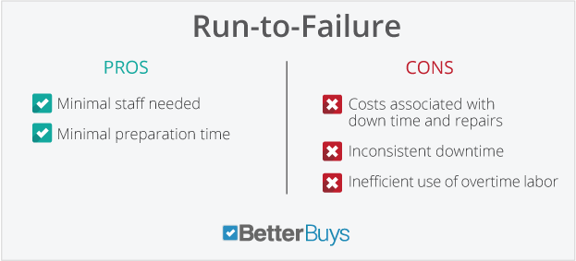
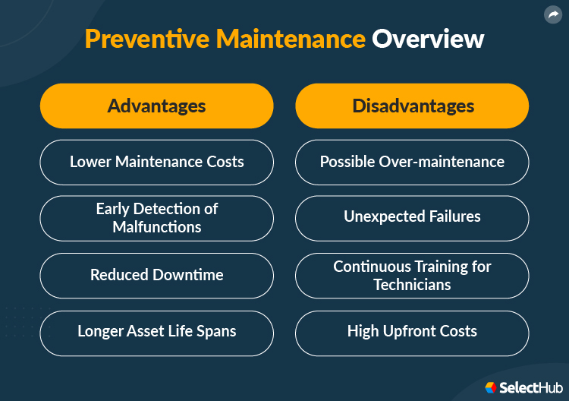
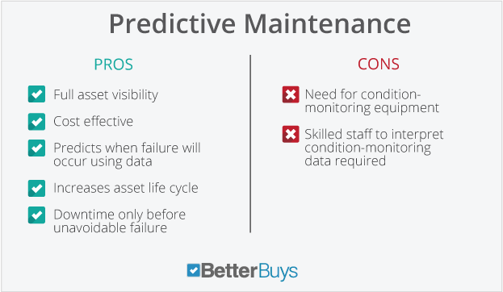
Disadvantages of Predictive Maintenance.
Misinterpretation of data.
Unrealistically high cost of IoT (Von Birgelen et al., 2018).
Notes:
Misinterpretation of data could lead to false claims and false records resulting in unforeseen consequences and harming the organisation in every possible way. Unrealistic costing start-ups related to an organisation’s very own server with IoT is a burden and if somehow any error or technical difficulty comes up, the organisation is at grave risk of losing every single data and having irreversible damage done to them through that small mistake or error.

Slide 13
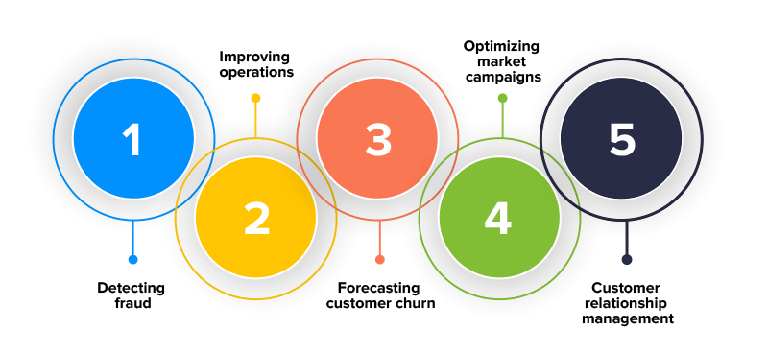
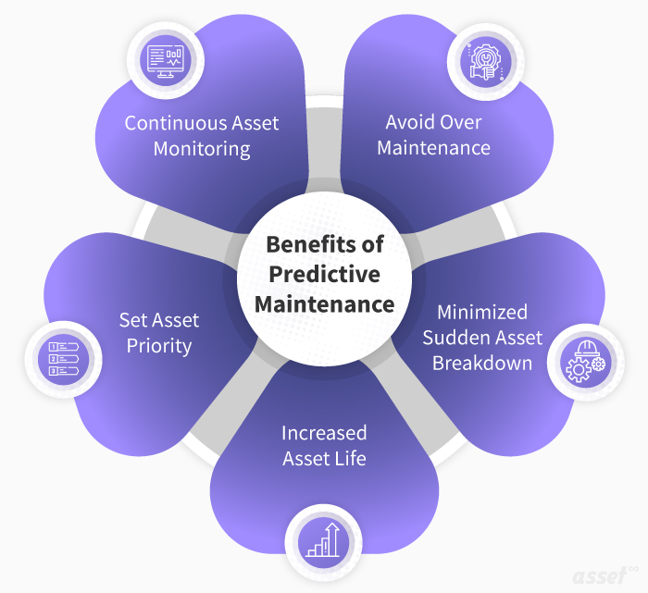
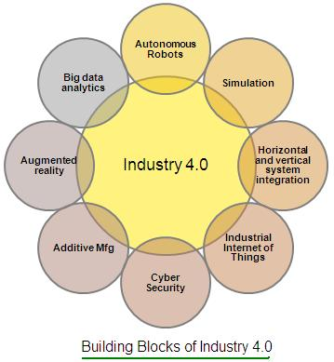
Conclusion
Predictive Maintenance and its Origin.
Predictive Analysis and Industry 4.0.
Advantages, Limitations, Disadvantages and everything in a nutshell.
Notes:
In conclusion, Predictive Analysis and Industry 4.0 are working in harmony (most of the time) to create a profitable, cost-effective, mass appealing, cheaper than its competitors, and so on. Whereas Predictive Maintenance is when Predictive Analysis and a full-on combination of 4IR (4th Industrial Revolution) are merged and a sub-part is created for the handling of provisional tech on the field and off the field. Furthermore, this PowerPoint Representation has introduced and described specialities, advantages, limitations, and disadvantages. Lastly, this representation describes the importance and a few recommendations most organisations should follow for better management, production rates, reduced costs, hiring made easy, effective management team, providing privileges for the employees, technical team for the handling of server and IoT.

Slide 14


